Slide 1
Optimising Cadastral Services for African Development- the Case of AGIS
By
Isa Ibrahim Jalo Ph.D
Director/CEO, Abuja Geographic Information Systems
isajalo@agis.fcta.gov.ng

Slide 2
AGIS
The Official Provider of Geo-information
Services and Products in the Federal Capital Territory

Slide 3
The Conception of AGIS
The Abuja Geographic Information Systems (AGIS) is the result of the decision taken by Government of the Federation in 2004 to embark on a complete computerization of the cadaster (survey data) and land registry of the FCT.
Within ten years of its establishment, the Agency was able to record some success in revolutionizing the operations of the Land Administration and to some extent, other land related departments of the FCT.

Slide 4
Mandate
Generation, Management and Administration of Geospatial Data and Land Matters in the Federal Capital Territory
(FCTA Order, 2004)

Slide 5
AGIS Scope
Services for Government, Professionals and Citizens
The official source for spatial data on FCT
Computerization of spatially related workflows in selected FCTA departments and agencies

Slide 6
The Mission of AGIS
The mission of AGIS is to develop a comprehensive, all-inclusive, fool-proof, state-of-the-arts, computerised Geospatial Data Infrastructure (GDI) for the FCT.
The Vision of AGIS
The Vision of AGIS is to become the only official source of Geospatial Data for the nation’s capital.

Slide 7
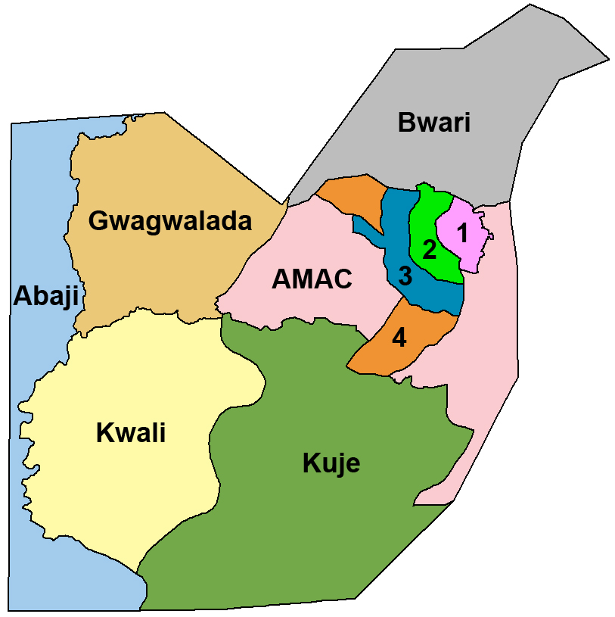
The FCC & Area Councils of FCT

Slide 8
Process of Land Titling In FCT
Land Applicants – Ministerial Approvals
Deeds Registration, C of O Printing and Transactions Registration, etc
(Land Administration Department).
Plot sourcing – Land subdivisions
Land use Planning, detailed site development plans, etc. (URP)
The Intelligent Sheet – Charting & TDP productions, cadastral mapping, survey controls establishment, etc.

Slide 9
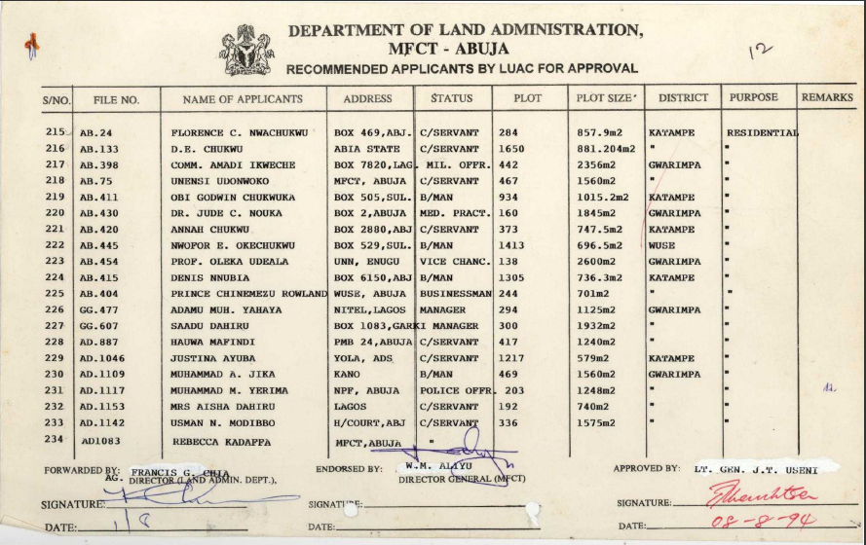
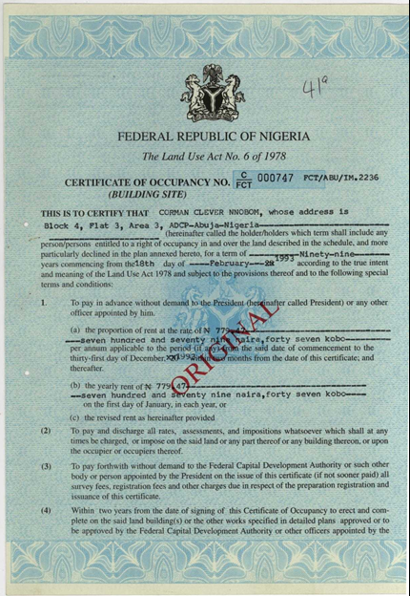
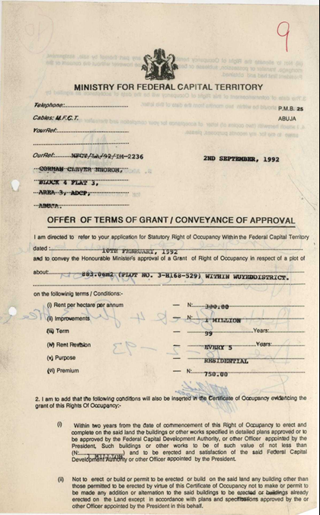
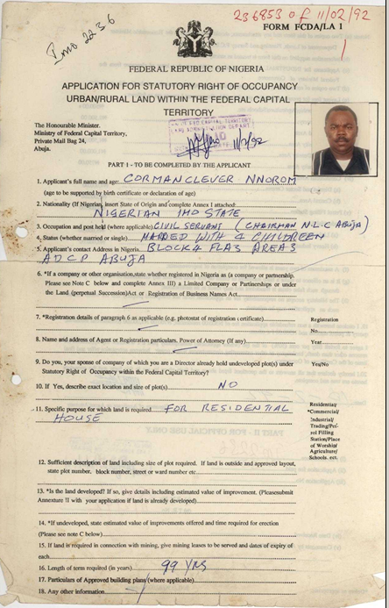
Land Titling Before AGIS
Ministerial Approval sheet
Certificate of Occupancy
Land Application form
Letter of Offer (R of O)

Slide 10
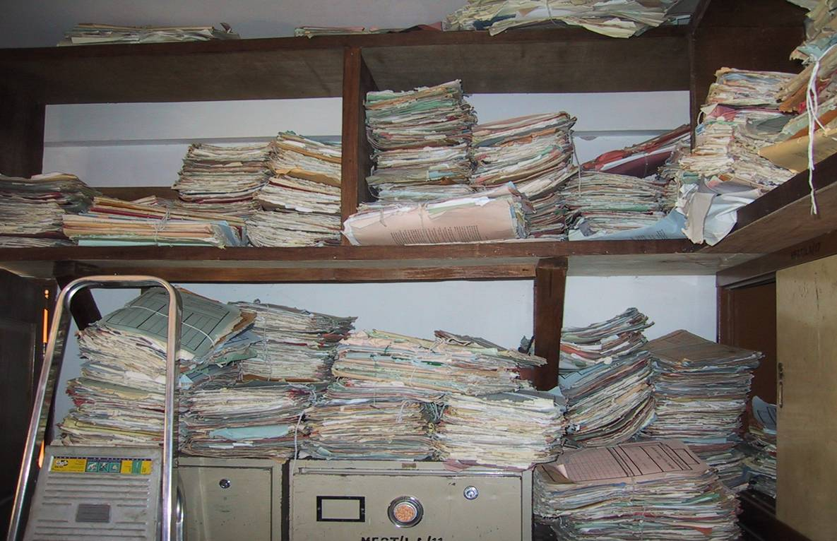
RECORDS KEEPING BEFORE AGIS

Slide 11
Problems in the Old system
Challenges in the old manual system was basically lack of good records keeping which resulted in:
Unattended applications
Multiple allocations
Unclear situations in land allocation
Mismatches in land use
Encroachments on rights-of-way, property boundaries
Misuse of public properties
Forgeries of land documents
Illegal allocations from "Parallel Office"
Inefficient revenue generation and collection

Slide 12
Why Computerize?
In realization of the above problems associated with manual system of record keeping and the
rapid rate at which the City and its environs are growing, the past FCTA/FCDA made several attempts to computerise the system.
Those attempts failed
because of gross under estimation of enormity of the problems as well as the lack of strong
political will to successfully pursue the actualisation of the exercise.

Slide 13
Objectives of the AGIS Project
Computerization of the Land Registry
Computerization of the Cadastral maps of Phases 1,2 & 3 of the FCC
Identification of multiple allocations of plots and eliminate them
Subsequently to fully computerize the remaining phases of the City and the remaining parts of the FCT
Provisions of land data, as well as detailed maps of the City and those of the Area Councils (i.e. municipal and local government administration)
The products at the end should include information related to the ownership of plots as well as historical information such as changes in property ownership etc.
To be able to set up Abuja Geographic Information Systems (AGIS) as only source of geospatial information for the FCT.
The system should guarantee CONTINUITY, SCALABILITY, FLEXIBILITY,
CONSISTENCY, and SUSTAINABILITY

Slide 14
FCT Land related Department
Land Administration
Urban and Regional Planning
Development Control
Survey and Mapping
Resettlement and Compensation
Engineering Services
FCT Water Board
Abuja Environmental Protection Board,(AEPB)
Satellite Towns Development Agency,(STDA)

Slide 15
DATA SOURCES

Slide 16
Primary Data Sources for AGIS
Topo Maps, Cadastral Maps, Cadastral Plans, Survey Data, etc.
Surveying & Mapping
AGIS
Landuse plans, Layout plans, Subdivision plans
Urban & Regional Planning
Land Admin.
Records of plot ownership from Files and Registers

Slide 17
DATA FROM SURVEYING AND MAPPING DEPARTMENT
Topographical Maps (1:250,000; 1:100,000; 1:50,000; 1:10,000)
Cadastral Maps (1:5,000, 1:2,000 & 1:1,000)
Cadastral Plans (Layouts and Titled Deeds Plans – TDP)
Survey Data (Plot No., Property Beacon Nos, Coordinates, Bearings, Distances and Size of plot)

Slide 18
DATA FROM URBAN AND REGIONAL PLANNING DEPARTMENT
Land use Plans
Detailed Site Development Plans
Subdivision Layout Plans, etc.
18

Slide 19
DATA FROM LAND ADMINISTRATION DEPARTMENT
Records of Land Applicants
Records of Land Allocations
Records of Certificates of Occupancy
Records of Land transactions, etc.

Slide 20
Other Sources of Data for AGIS
Area Councils
Engineering Services
Surveying & Mapping
Water Board
AGIS
Satellite Imagery
Transport Services
Urban & Regional Planning
Land Admin.
FGN Houses
Resettlement and Compensation
Mass Housing
Development Control

Slide 21
AGIS PROJECT IMPLEMENTATION

Slide 23
Database Design
Land Information System(LIS) Database: This contains the attribute tables for Plot Owners and applicants, Land transactions, Real Estate policies, etc.
Geographic Information System(GIS) Database: contains attribute structure for point features, polygon features, line features, etc.
Document Management System (DMS) Database: contains scanned copies of policy files, registration documents, transaction records, etc.

Slide 24
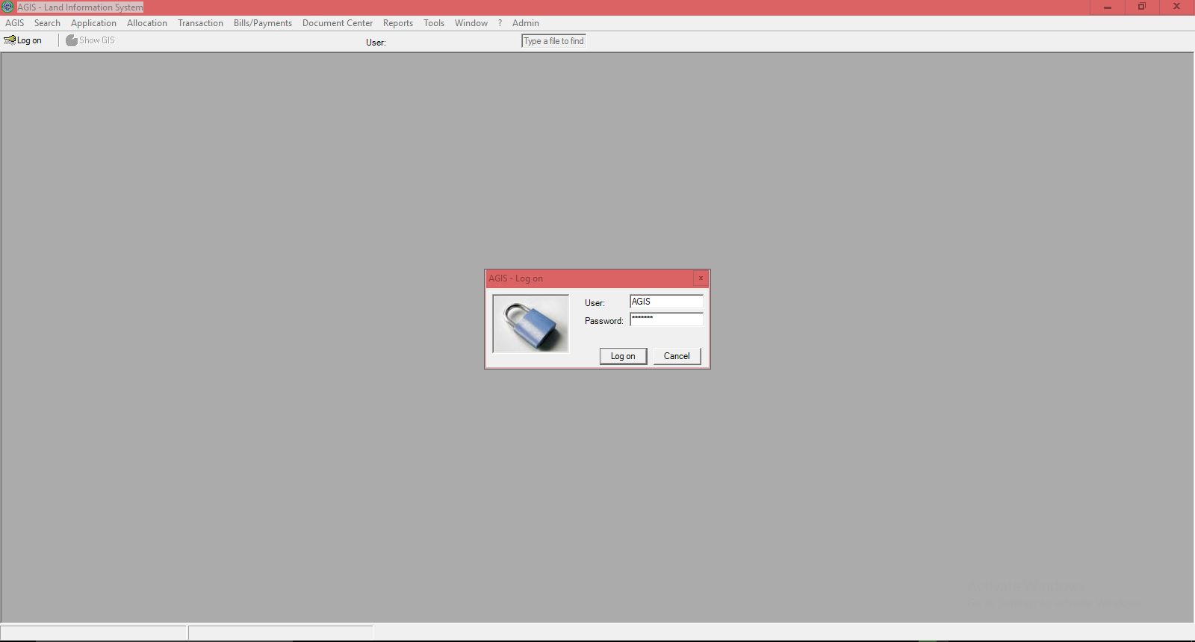
AGIS Land Information System (LIS)

Slide 25
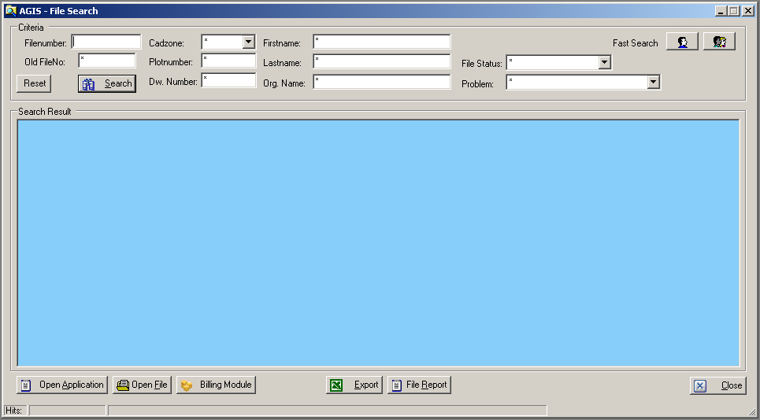
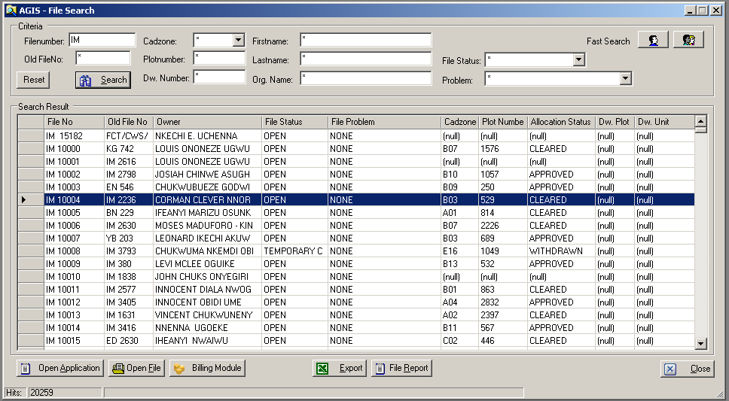
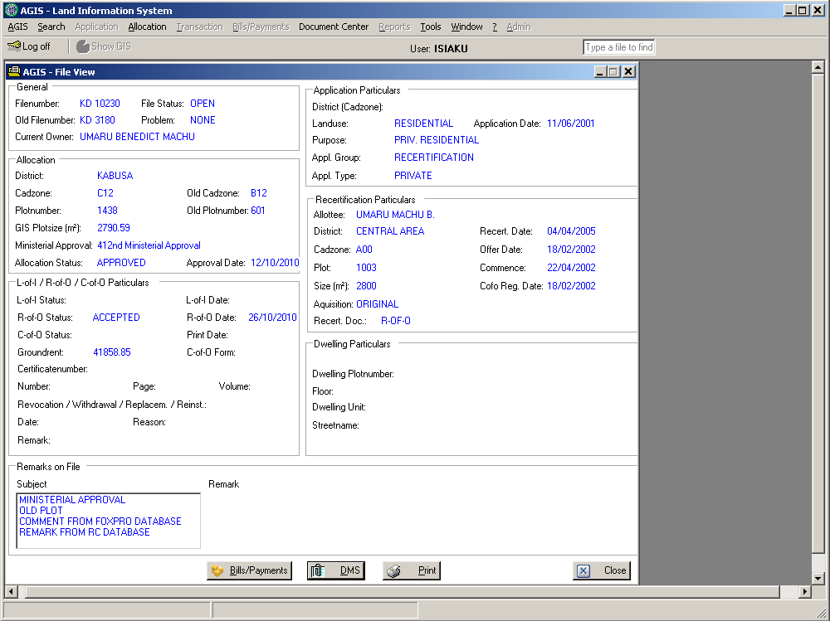
AGIS LIS

Slide 26
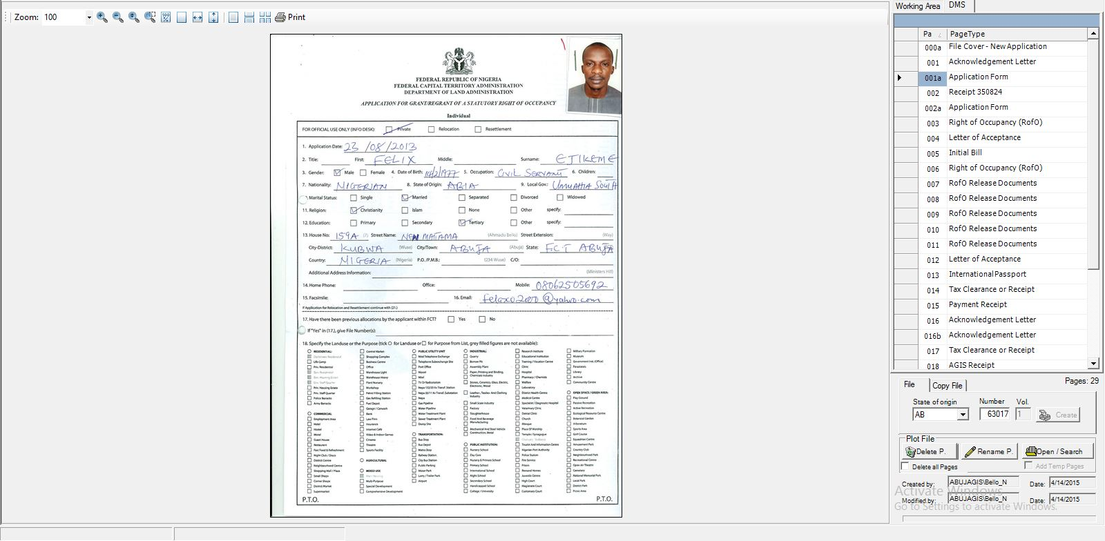
AGIS Electronic Document Management System (e-DMS)

Slide 27
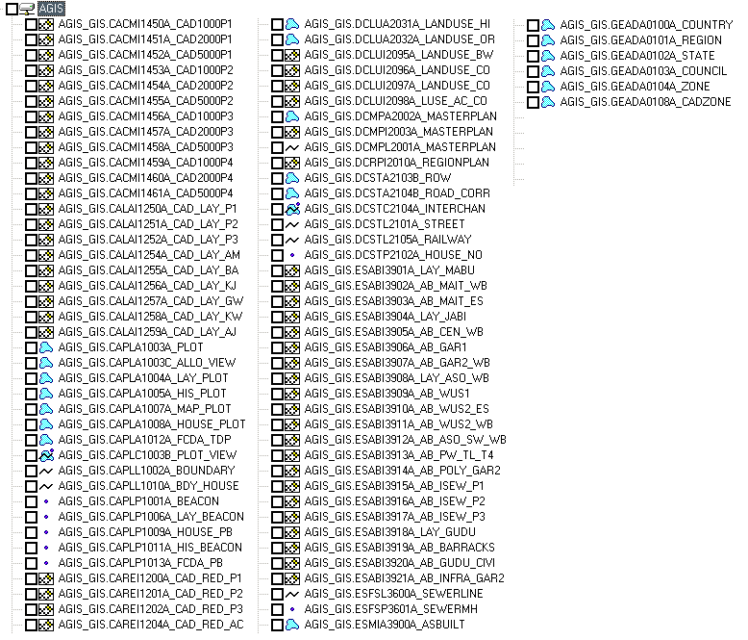
AGIS GIS features classes
Point
Line
Polygon
Compound
Raster

Slide 28
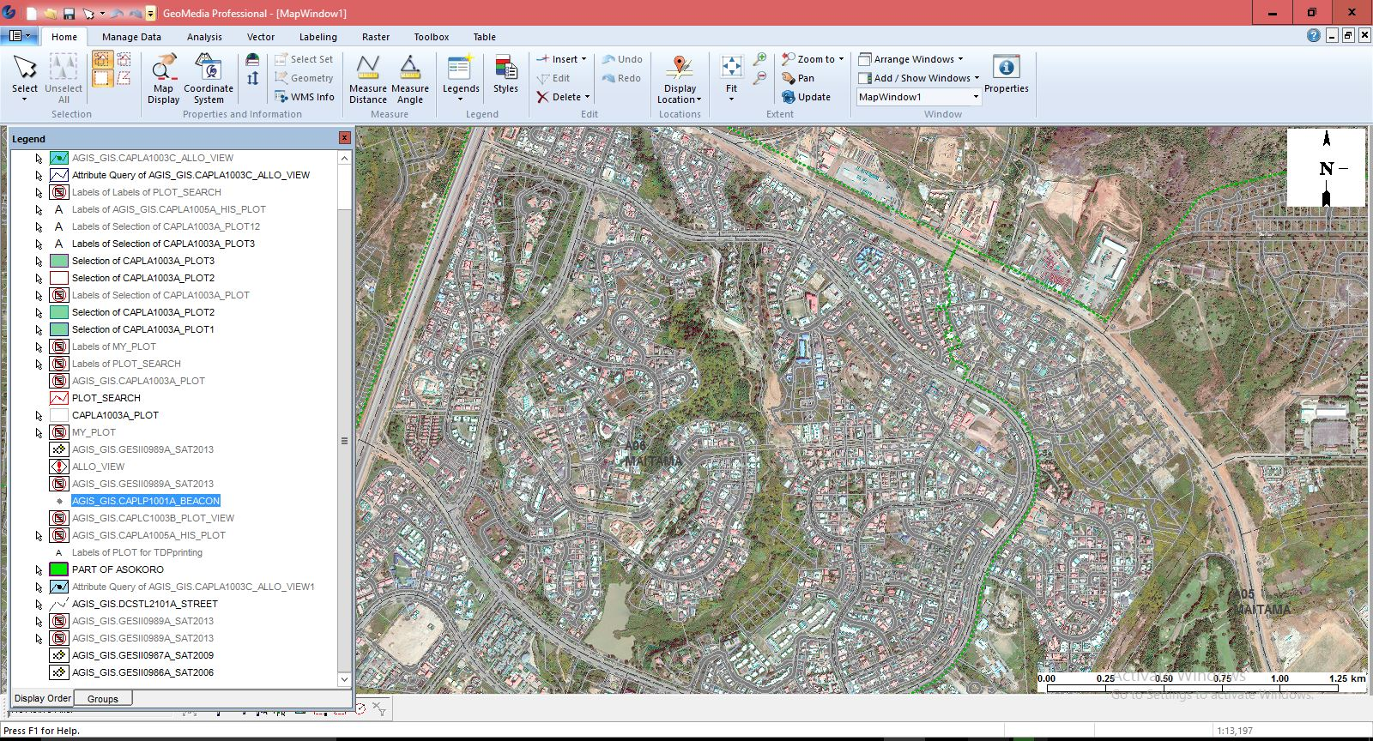
AGIS Geographic Information System (GIS)

Slide 29
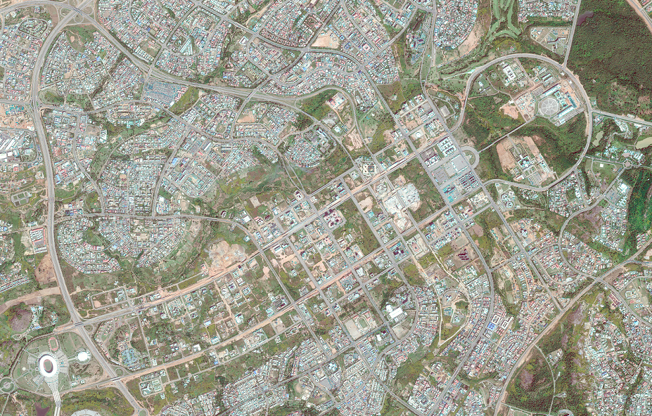
AGIS GIS Satellite Image

Slide 30
REVENUE COLLECTION

Slide 31
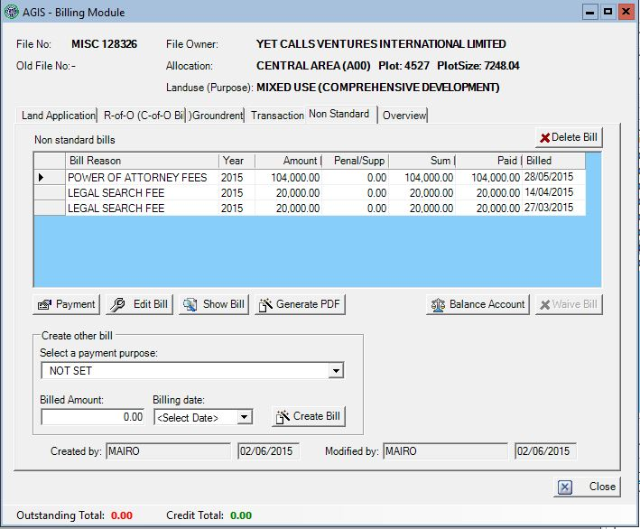
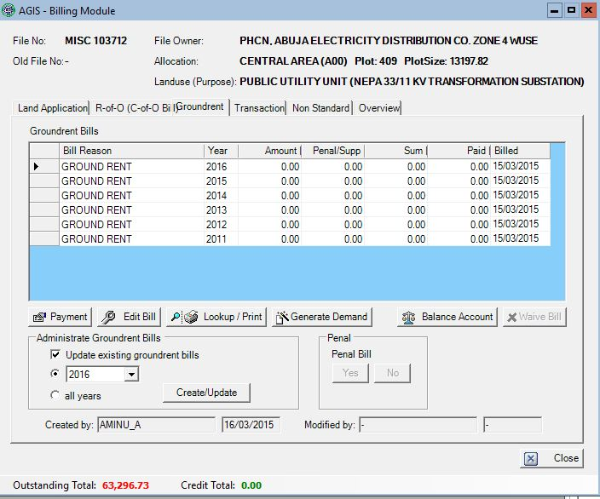
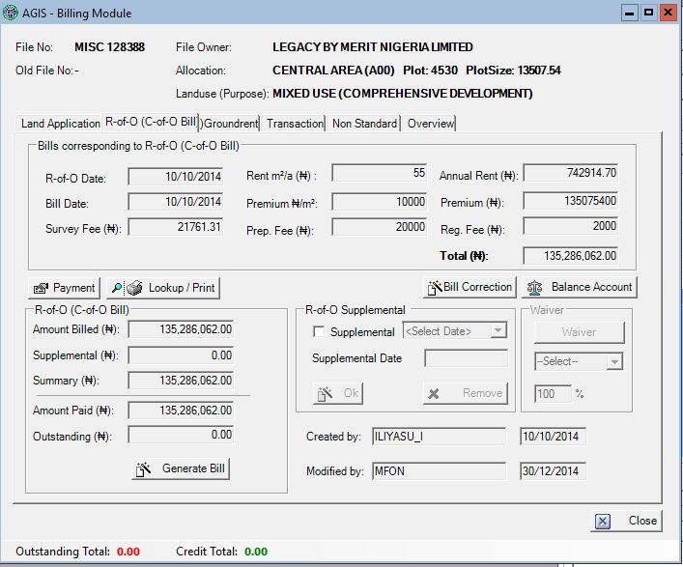
Automated Billing Process

Slide 32
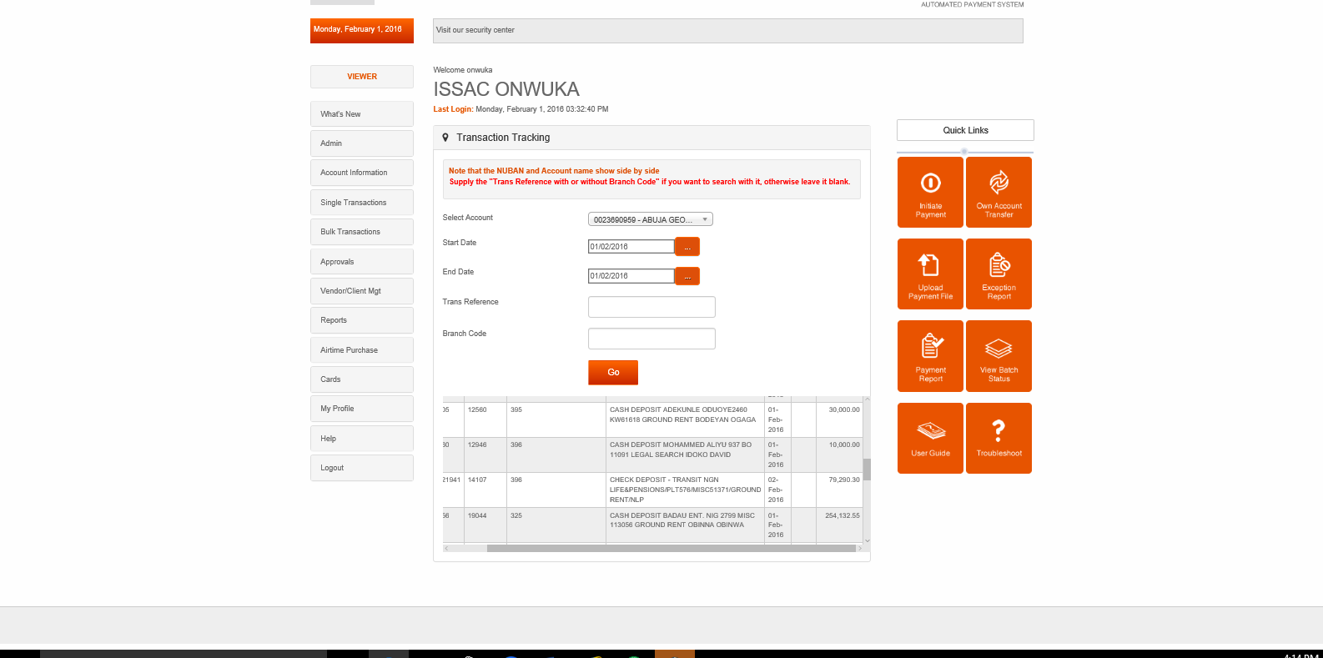
Electronic Collection
AGIS USER

Slide 33
AGIS Revenue Performance
S/NO | PERIOD | BUDGETARY PROVISION(N) | ACTUAL COLLECTION(N) | PERCENTAGE PERFORMANCE
1 | 2011 | 28.872,677,309.15 | 16,169,689,153.06 ($44M) | 56%
2 | 2012 | 27,414,833,092.00 | 13,376,938,714.56 ($37M) | 49%
3 | 2013 | 20,241,835,947.00 | 15,678,881,411.34 ($40M | 78%
4 | 2014 | 18,167,805,804.83 | 13,744,511,631.66 (($38M) | 76%
5 | 2015 | 23,421,942,415.35 | 12,247,144,733.07(as at Q3 2015) | 52%

Slide 34
Products of AGIS
Computerized Land Allocation processes
Computerized C of O productions
Computerized Cadastral Data for the FCC
Computerized Cadastral map production for the FCT
Digital Street guide map for FCC, etc.
Revenue Collection and remittance

Slide 35
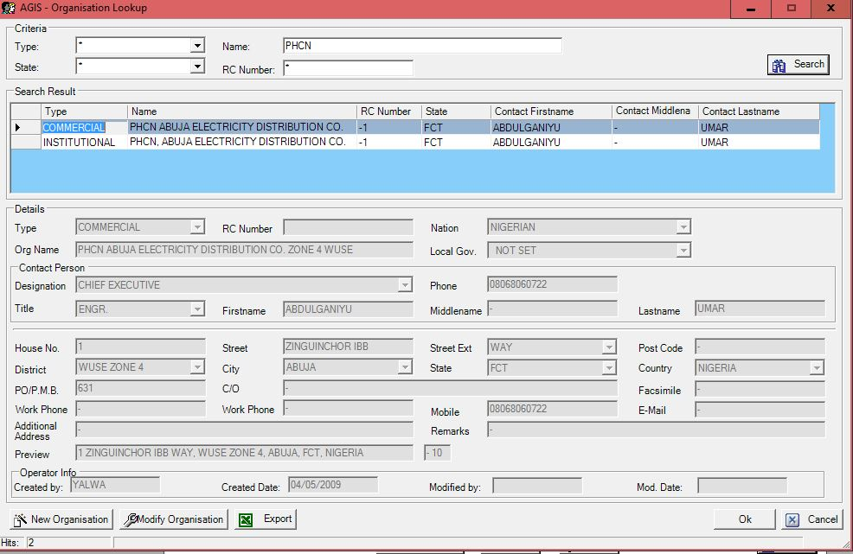
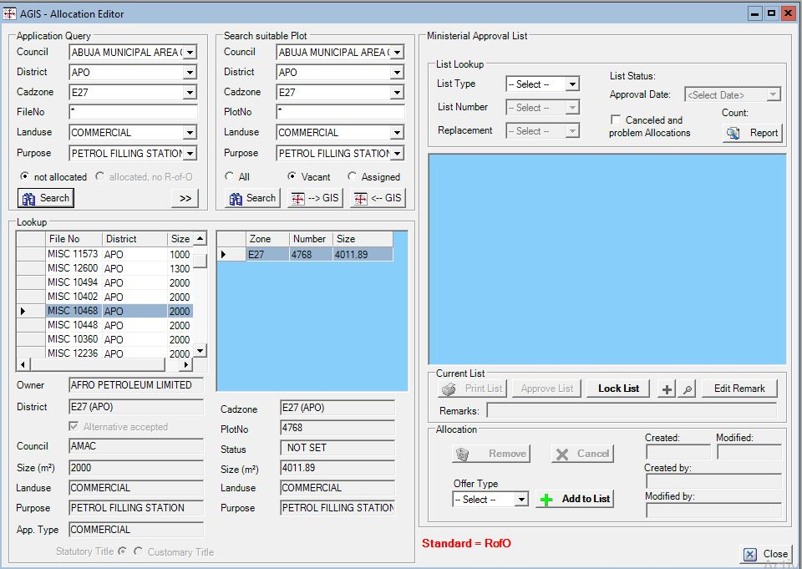
Application/Allocation Module

Slide 36
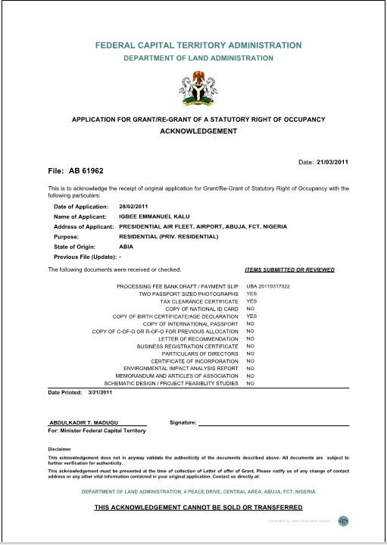
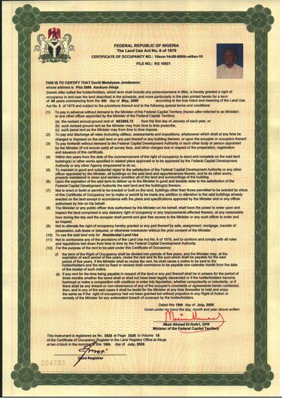
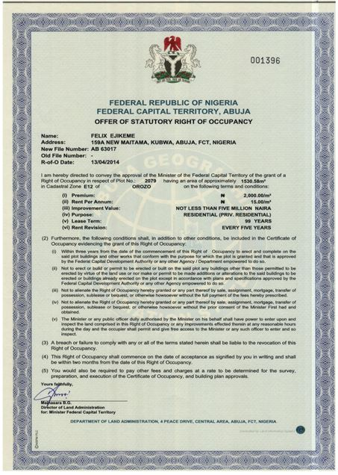
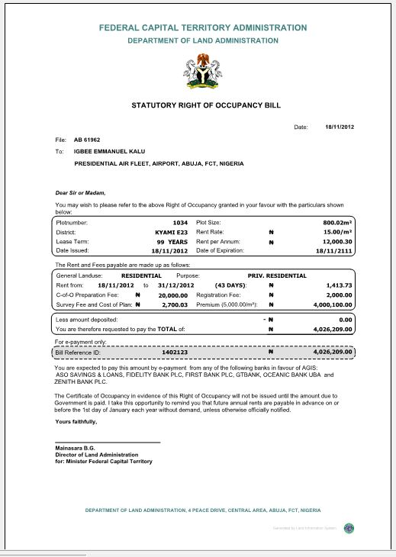
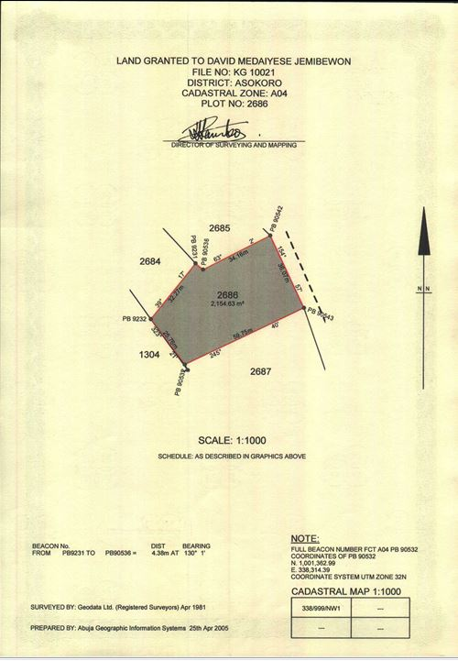
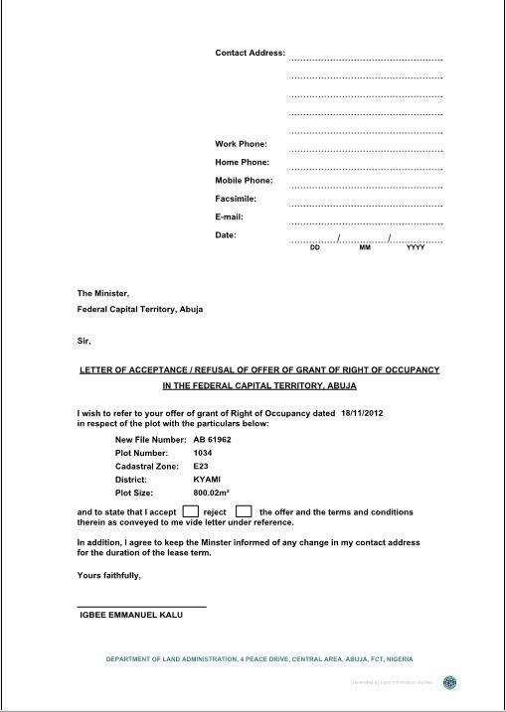
Computerized Land Administration
Letter of Offer (R of O)
Certificate of Occupancy (C of O)
Letter of Acknowledgement
C of O Bill
Title Deeds Plan (TDP)
Letter of Acceptance

Slide 37
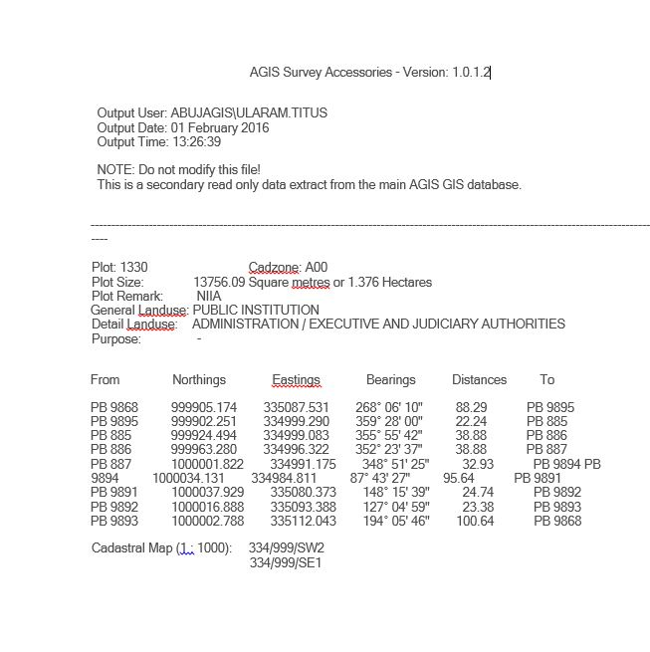
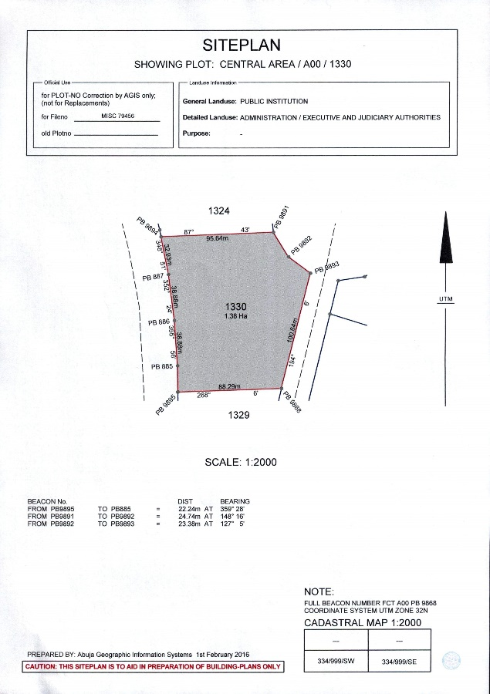
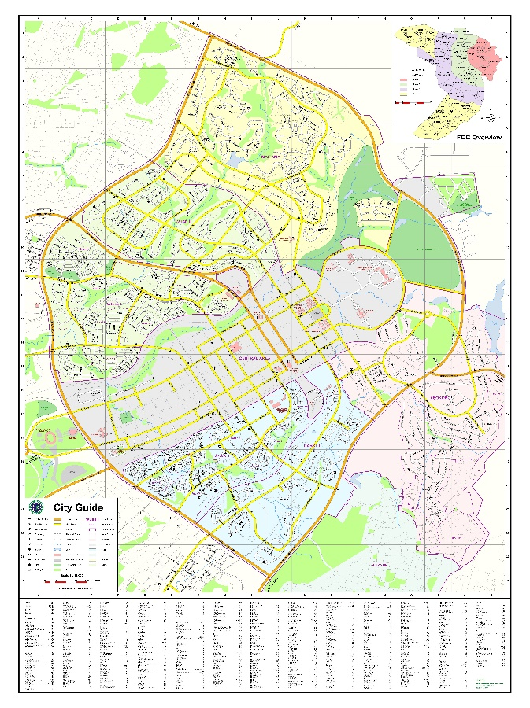
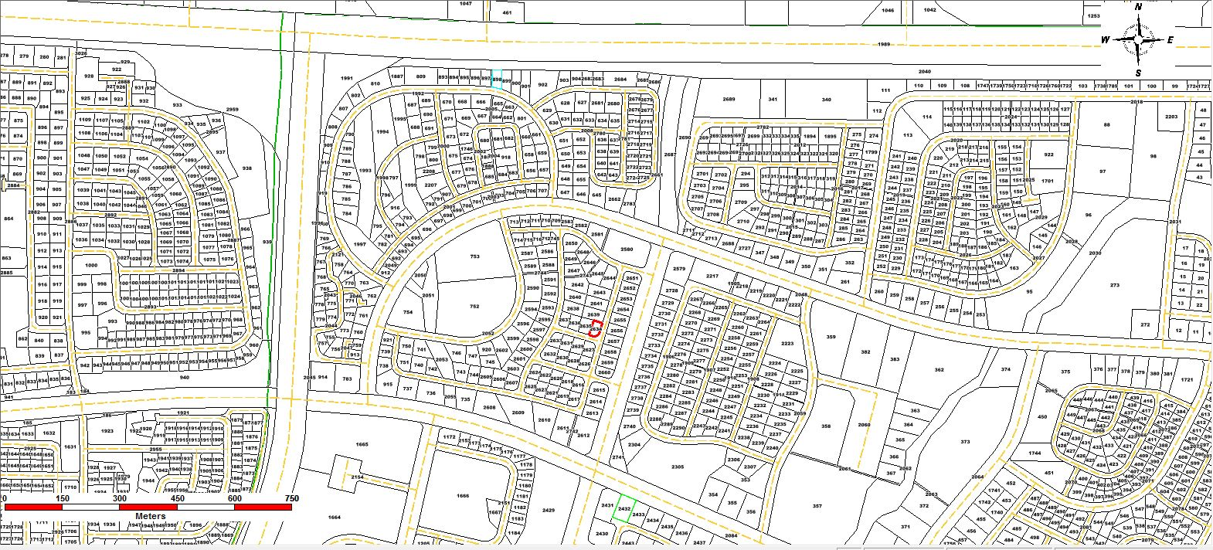
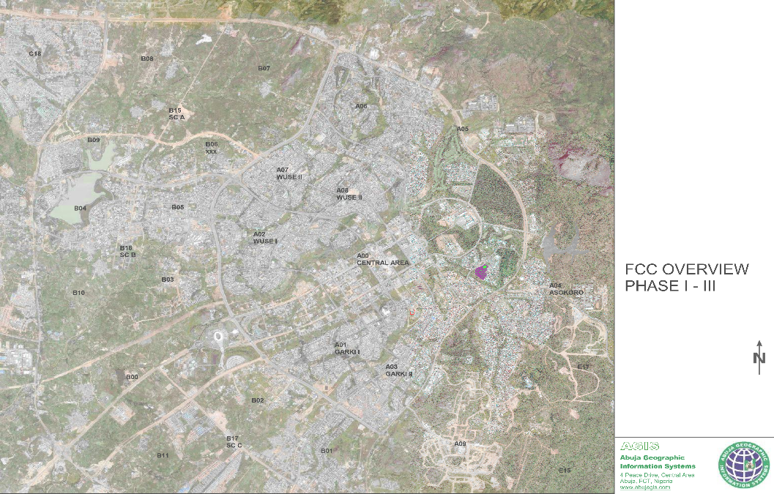
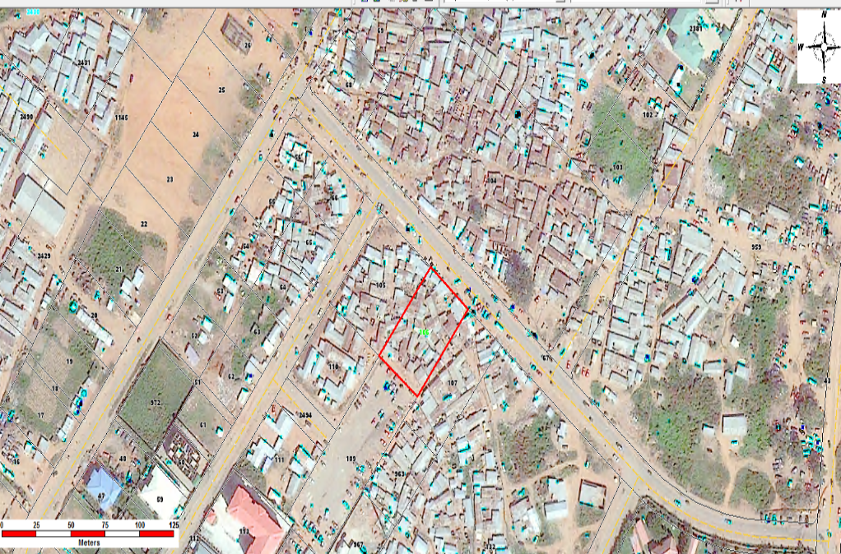
GIS Products
Cadastral Layout
Survey Data
Site Plan
Plot Coordinates (Data)
City Guide
District Map
Aerial Map

Slide 38
AGIS as a Service Provider
ICT Support to Stakeholders
GIS Support to Land related Department
GIS data to Government and organizations
Online and Mobile Services to Administration and citizen
Data Hosting for Selected FCT Departments
GIS Data for Navigation
Providing platform for smart City Initiatives

Slide 39
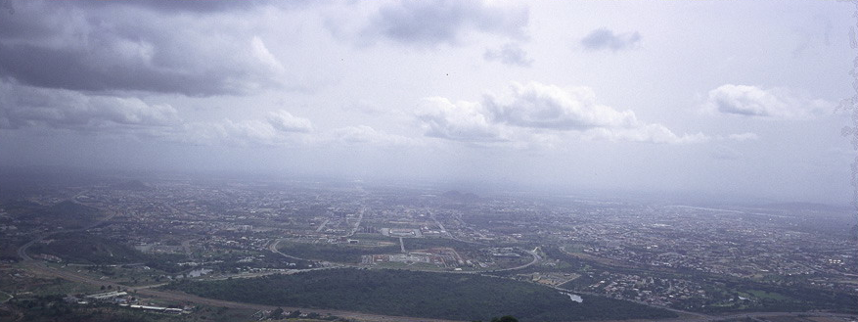
THANK YOU
www.agis.fcta.gov.ng
isajalo@agis.fcta.gov.ng

