Slide 1
The Internet Governance Challenge: The Changing Face of the Internet
Implications for African Business Leaders – Engagement and Leadership
Marilyn Cade, ICT Strategies
mCADE LLC
June 2015

Slide 2

Internet Governance: The Dilemma of the Nine Blind Men and the Elephant
  The Changing Nature of the Internet and its users:
  Challenges or Opportunities?
  Critical and Ongoing Debates:
  What is Internet Governance?
  Who is in Charge of the Internet?
  What is Enhanced Cooperation?
  Issues Under debate – an evolving palette of issues
  Calendar of Events focusing on IG
    Internet Governance Forum
    Internet Governance - Post WSIS –WSIS +10 Review–Discussion and Activities – Implications for the Internet Society, and Internet Economy
    Enhanced Cooperation – Status Update
    Sustainable Development Goals – the new “sun” around what other issues will revolve post 2015
  Core IG organizations – The landscape of Interested organizations; what they are doing
  Building and Influencing global institutions and organizations to support multi stakeholder engagement

Slide 3
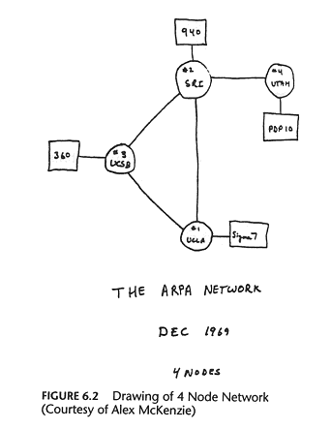
Internet – At its Inception
Computer Hosts in
1969
First 4:
1. University of California Los Angeles (UCLA)
2. University of California Santa Barbara (UCSB)
3. University of Utah
4. Stanford Research Institute (SRI)

Slide 4
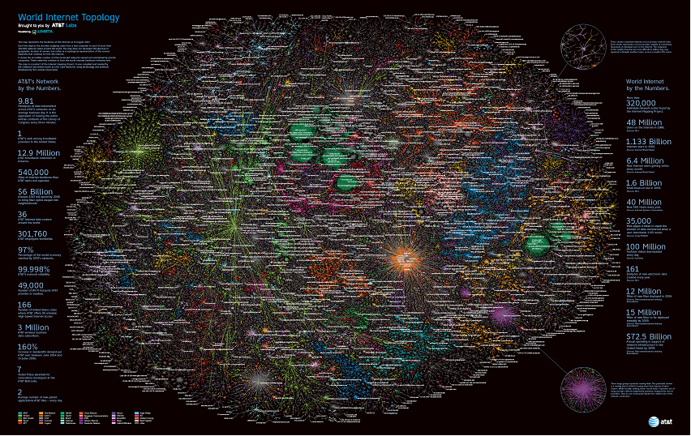
Internet
Notes:
.

Slide 5

The Internet and the Online World --– Traffic and Users Changing monthly
157 Million
Blogs-
Tumbir
and Wordpress
163 Billion +
Tweets/year
2,405,518,376
Billion +
Internet Users
Over 4 Billion Video
Playbacks on Youtube
Per Day
634 Million
Websites
107+ Trillion
Emails Sent
1.06 Billion
Facebook Users
4.3 Billion
Email
Accounts
http://www.internetworldstats.com/facebook.htm
http://247wallst.com/2012/10/04/facebook-users-now-total-1-billion/
http://thenextweb.com/facebook/2013/01/30/facebook-passes-1-06-billion-monthly-active-users-680-million-mobile-users-and-618-million-daily-users/
http://royal.pingdom.com/2013/01/16/internet-2012-in-numbers/
http://royal.pingdom.com/2013/02/26/pinterest-users-per-employee/

Slide 6























The Internet Governance Landscape
CSTD
Civil Society Groups
-CDT
-AccessNow
-APC
-Freedom House
-Privacy Int’l
-citizen lab
…….
UNGA
G-7
marilynscade@hotmail.com

Slide 7
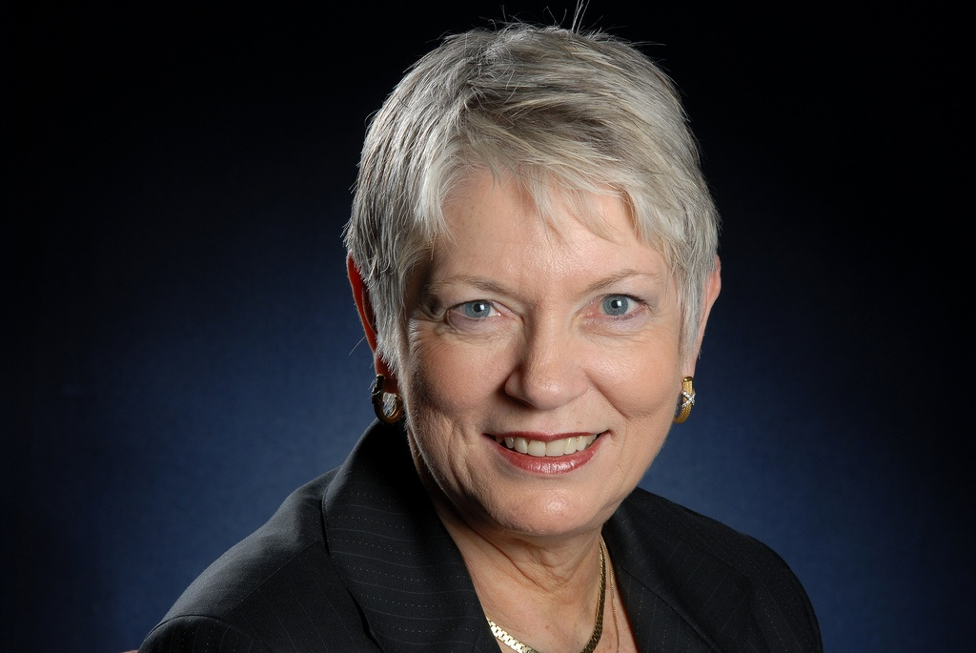

Marilyn Cade
ICT Strategies mCADE llc marilynscade@hotmail.com
1 202 251 6787
Marilyn Cade is the Principal and CEO of ICT Strategies, mCADE llc. Cade works at the nexus of Internet, information and communications technology (ICT) and global public policy in global forums in relation to the Internet and its changing role as a critical communications infrastructure and global contributor to social and economic growth. She is currently engaged in bringing the voice of business and associations into Internet Governance and post 2015 Development and WSIS+10 events and activities.
Cade has a unique focus on policy activities that promote economic growth and sustainability. She is an expert in several policy areas related to Internet, online commerce, and emerging applications. She brings a unique perspective that has helped to bridge the interests of global corporations with developing and emerging economies. Her background includes US State Government, non governmental organizations, corporate business, and start up initiatives within a major global corporation. She has also developed, launched, and supported major policy initiatives on a wide variety of online topics.
Cade’s focus is working at the nexus of information and communications technology (ICT) and global public policy in global forums in relation to the Internet and its changing role as a critical communications infrastructure. She is actively involved in discussion regarding global economic recovery; Internet Governance and post WSIS activities, organizing and representing industry perspectives on Internet Governance.
Cade is appointed by the UN Secretary General to the IGF Multi stakeholder Advisory Group (MAG), and is a member of the Executive Board of the IGF Support Association. Cade has extensive expertise in multi lateral organizations, such as the ITU, OECD, UNESCO, APEC, ICANN.
Cade is a member of the Commission on Science and Technology for Development Working Group on Enhanced Cooperation. She is also the Chief Catalyst at IGF-USA, a national IGF Initiative (www.igf-usa.us).
Cade holds a B.S. in Sociology, Southwest Missouri State College/University of Missouri; a M.S.W [Organizational Development], St Louis University, Missouri. Her background includes extensive experience in organizational development and professional training, as well as extensive technical training.

Slide 8
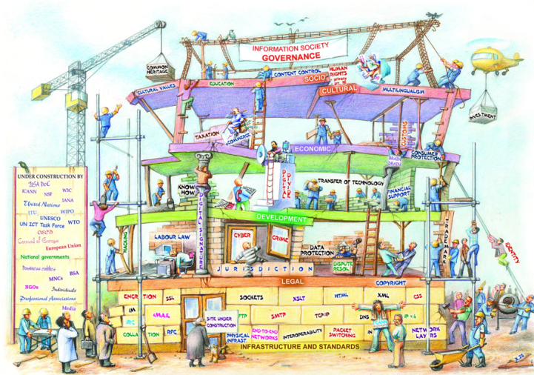
Internet Governance – Under Construction
Copyright by DIPLO

Slide 9
Internet Governance: Policy Issues
Policy Issues
Policy Issues, cont’d
Cyber Security – Info/Apps and Networks
Privacy
Choice of Law/Jurisdiction
Liability of Internet Service Providers
Cyber Crime
Data Protection/localization of data storage
Access – Affordability and Availability – Broadband and Mobile
Technologies driving social, economic or political change
Capacity Building
ICANN’s Role and Responsibilities
  New GTLDs
  IDNs
  IANA Transition
  Accountability Mechanisms
  WHOIS Accuracy/Privacy Issues
  Role of National Govt’s
  Internationalization
Freedom of Expression
Multilingualism on the Web
Interconnection Costs
Spam
International Connectivity Costs/IXPs

Slide 10
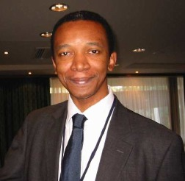
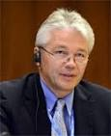
Leadership of IGF – Multi Stakeholder Advisory Group + Secretariat
Multistakeholder Advisory Committee
Advises UN Sec Gen
Appointed by UN Sec Gen
Chengetai Masango, Secretariat
Janis Karklins
Chair of MAG
MAG 2015
Notes:
Keep Markus Kummer?

Slide 11
Internet Governance Forum (IGF) 2015 http://www.intgovforum.org
Joao Passeo, Brazil
Day Zero – Nov 9
IGF Nov 10-13
Proceeded by a separate invitational Ministerial
Status of Planning: Workshops – 250+ proposals/evaluation by MAG
Approximately 107 /Open forums in Programme
60-70 High Level Governmental officials, including Ministers and Ambassadors
Likely to be a Consultation on WSIS +10 at the IGF2015 in Brazil
National and Regional IGF Initiatives -
Becoming engaged in the IGF, and in national and regional IGF Initiatives – www.intgovforum.org

Slide 12

Global Internet Governance Forums
Greece
2006
Lithuania
2010
Greece
2006
Lithuania
2010
Baku 2012
Azerbaijan 2012
Egypt
2009
Egypt
2009
Turkey
2014
India
2008
India
2008
Mexico – Invited
hosting
For 2016
Kenya
2011
Kenya
2011
Indonesia 2013
Indonesia 2013
Brazil
2007
Brazil
2007/2015

Slide 13
Regional and National IGF Initiatives
Notes:
Regional IGFs are squares, national IGFs are stars

Slide 14
Regional and National IGF Initiatives
Regional and Sub Regional IGF Initiatives
  Asia Pacific Regional IGF Caribbean IGF
  Central Africa IGF Commonwealth IGF Virtual
  East Africa IGF
  European Dialogue on Internet Governance (EuroDig)- 20 countries
  Latin America and Caribbean IGF – 20 + Countries
  West Africa IGF
  Asia Pacific IGF
  Arab States IGF
  African IGF
  IGF-USA
National IGF Initiatives
  Cote d’Ivoire IGF Denmark IGF Finland IGF
  Germany IGF Italy IGF Portugal IGF
  United Kingdom IGF Kenya
  Russia IGF Spain IGF Sweden IGF
  New Zealand IGF UK IGF
  Nigeria IGF The Gambia
Notes:
India IGF and Pacific IGF removed from previous list

Slide 15
The Road Ahead –Assessing Implementation of WSIS is consuming UN – SDGs, Financing mechanisms, IGF, Enhanced Cooperation… 2015 and beyond…
  Access is still a core challenge for not only the 3 B connected, but the next 4 Billion;
  Capacity building, affordable devices and resiliency are NOT solved
  Security versus privacy of data and communications – balance needs more focused debate
  Larger World Challenges Affecting Geo Politics – Five Major Threats as Drivers of Geo Politics – Water, Food, Energy, Safety, Climate Change implications for Environment
  Sustainable Development goals [17/over 170 targets] must be integrated into post 2015 WSIS agenda to advance Information Society and
  Affect role of business as leaders from developing countries and continents
  Happening Now: WSIS +10
  WSIS +10 Evaluation; Launch of Post 2015 Sustainable Goals Framework
  Agreement to hold a Two Day High Level Event at UNGA – Dec 2015
  What just happened in NY GA re SDGs and ICTS and
  Two Day launch of WSIS +10 process begins marathon toward December 2015
  Preparatory Process carries risks and opportunities for business for Developing Countries
  Collision of Perspectives Driving some of the global fora

Slide 16

The Challenge – and Opportunity of Beyond 2015 - Making WSIS+10 Review and Sustainable Development Goals [SDGs] work for the world post 2015

Slide 17
Questions ?
marilynscade@hotmail.com

